Slide 1

Crime Detection
Prepared By:
-Krupali Dobariya(18DIT014)
-Kevin Khunt(18DIT028)
-Yash Mistry(D19DIT081)

Slide 2
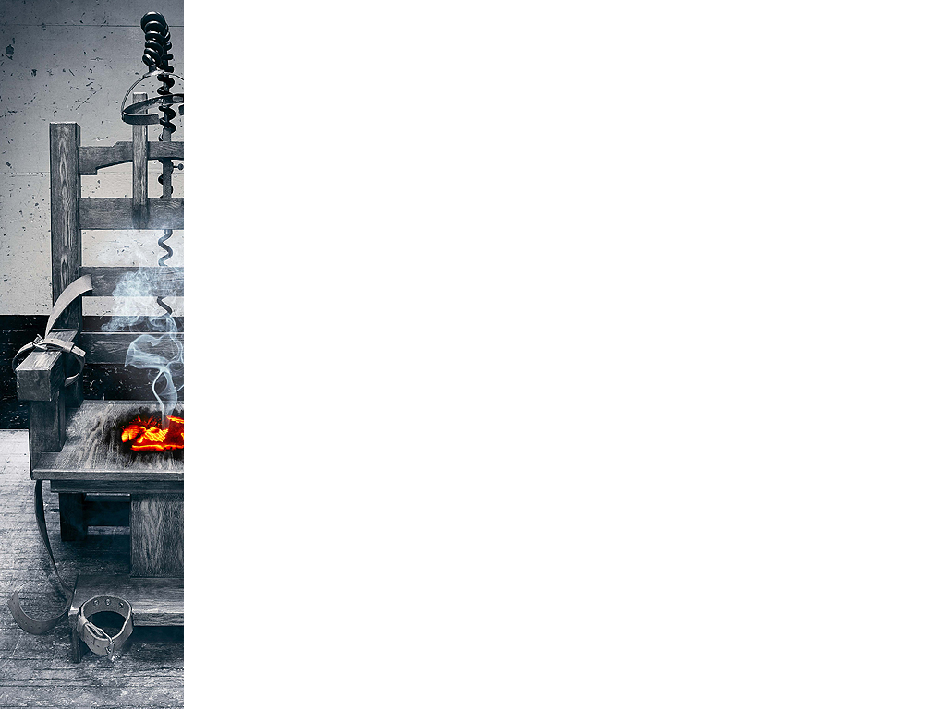
Contents
Introduction
Current System and its Limitations
Scope
Tools and Technology
Hardware and Software Requirement
Project Definition
Flow Chart
Snapshots
Learning Outcome
References

Slide 3
Introduction
As we know crime prevention plays an vital role in quality life of all citizen and using core methods of Machine learning its possible to make a program/application to help make it maintain.
Our project focuses on analysing crime rate with an process of Data gathering, Classification and Prediction.
With help of entities like location, number of crimes, and time from the dataset, we anticipate crimes.

Slide 4
Current System and its limitations
Less Accurate.
Limited Feature.
Time consuming.
No future prediction.

Slide 5
Scope
Efficient prediction.
Reduced time consumption.
Accurate result
Various ways to predict.

Slide 6
Tools and Technology
Python.
Jupyter notebook.

Slide 7
Hardware and Software Requirement
Minimum Hardware Requirement:
Intel(R)core(TM) i3-3200.
2GB of RAM memory.
1GB of Secondary storage.
Intel UHD Graphics 620.
Minimum Software Requirement:
Operating System: Windows 7 or higher, Linux.
Development language: Python
Interpreter: Python IDLE(3.7), Jupyter Notebook.

Slide 8
Project Definition
Give accurate dataset.
Pandas –
Pre-processing: Format data for pre-processing.
: Removal of null values , Filling of incomplete data.
Matplotlib –
Data visualisation: Meaningful visualisation using graph like bar , chart ,scatter.

Slide 9
Project Definition
Numpy -
Data manipulation : Easy and efficient data calculation within dataset.
Sklearn –
Data analysis and prediction : model trained using Random Forest classifier and predict based on that.

Slide 10
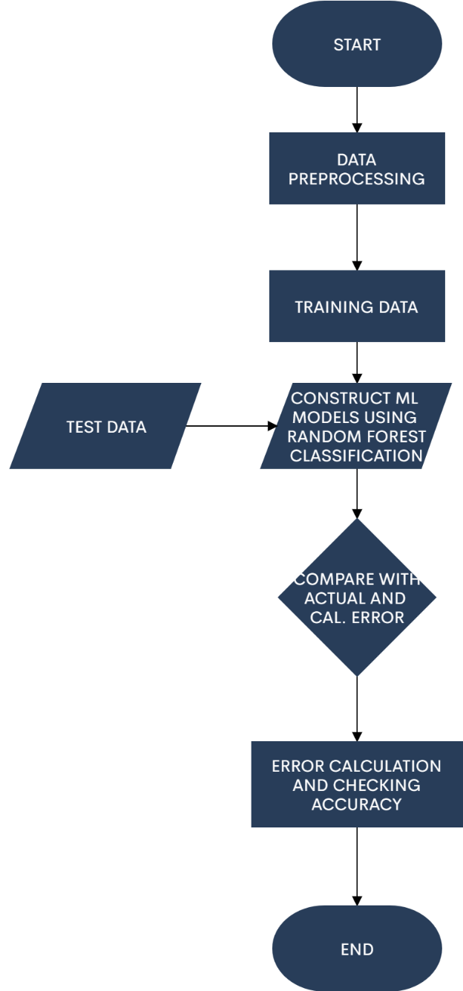
Flow Chart

Slide 11
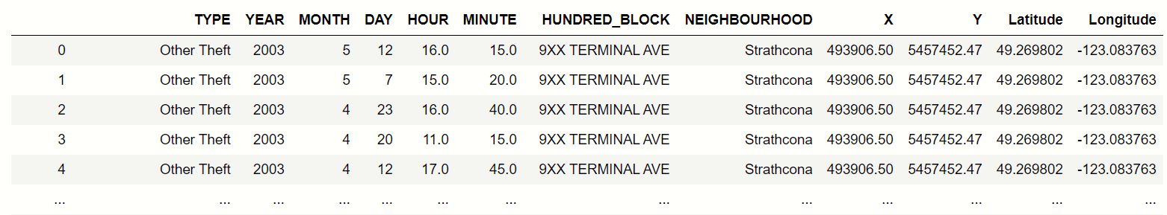
Snapshots
Dataset

Slide 12
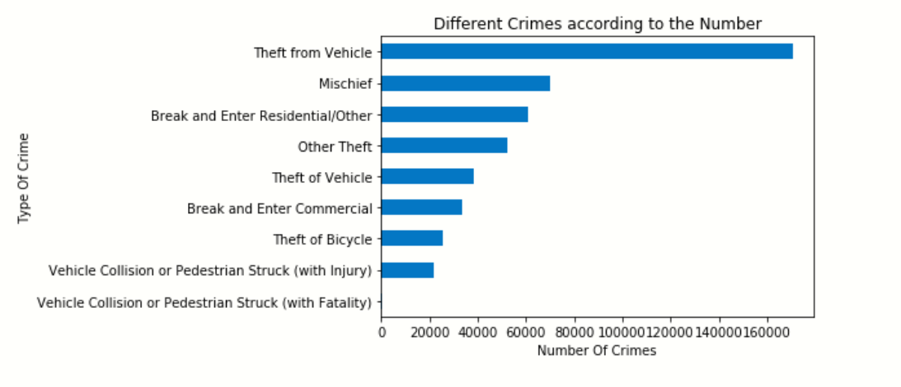
Snapshots
Types of Crime

Slide 13
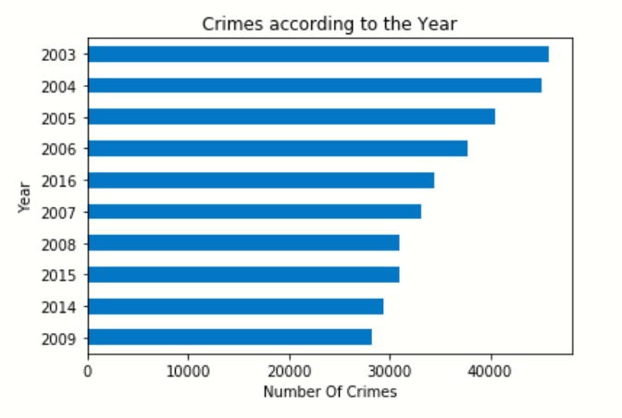
Snapshots
Crime According to the year

Slide 14
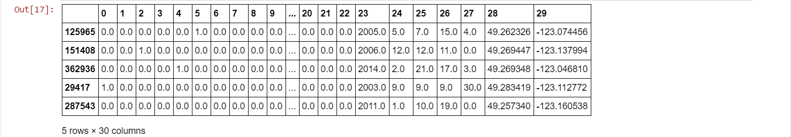
Snapshots
Splitting data into train set and test set using train_test_split of sklearn.model_selection library.
Using metrics function of sklearn library for getting the accuracy of our model.

Slide 15
Learning Outcome
Selection of suitable dataset.
Techniques of data pre-processing.
Various methods of data visualisation.
selection of appropriate model.
Various libraries of python.

Slide 16
References
https://www.geeksforgeeks.org/python-introduction-matplotlib/
https://www.udemy.com/course/machinelearning/
https://towardsdatascience.com/machine-learning-basics-with-the-k-nearest-neighbors-algorithm-6a6e71d01761
https://towardsdatascience.com/data-preprocessing-concepts-fa946d11c825
https://www.learndatasci.com/tutorials/python-pandas-tutorial-complete-introduction-for-beginners/

Slide 17
